Slide 1
Program Overview for Wisconsin
For more information, visit: www.AmericanBoard.org
Notes:
First slide of ABCTE

Slide 2
American Board: A Summary
We are a non-profit organization, founded in 2001 by a grant from the U.S. Department of Education.
We are an alternative route to teacher certification in over a dozen states.
We help career changers earn teacher certification without returning to school or taking out student loans.
We help communities deal with the teacher shortage by placing local, talented professionals in the classroom to share their experiences while educating the next generation of Americans.

Slide 3
How It Works
All you need:
A Bachelor’s Degree in ANY field
Pass a standard Background Check
…that’s it!
What you do:
Study online for two exams- a subject area exam and our Professional Teacher Knowledge exam (PTK)
Take and pass these two exams to earn our Teacher Certification

Slide 4
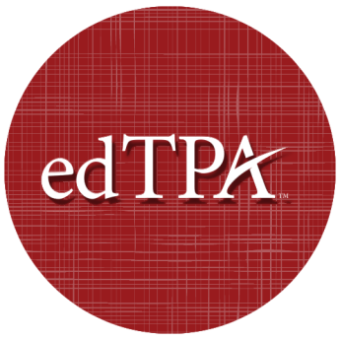
edTPA is not required
Please Note:
The edTPA is not required for our program.
Notes:
Mention that it is the only path to teacher certification that doesn’t require the edTPA for Completion. You should be familiar with what the edTPA is and what it involves.

Slide 5
How It Works
Candidates of the program have 12 MONTHS from the date of enrollment to work with our fully self-paced, self study program (average time to complete the program is 7-10 months).
Once you are ready to take either exam, you sign up at your local Pearson VUE Testing Center.
Notes:
Studying 5-8 hours per week

Slide 6
How It Works
After both exams are passed, students will receive their American Board Teacher Certification.
You present this to the state department of education and apply and complete their professional development requirements (don’t worry, those slides are coming up…)
You will teach on your provisional license for 3 years, while concurrently going through standard classroom observations and school district’s mentorship program.
Notes:
Point out here that the American Board teacher certification lasts for life, and that we have reciprocity with all other states that currently accept our certification.

Slide 7
Resources for you:
The American Board provides:
Online study materials (please note the History certification requires two physical textbooks; you can find them on Amazon.Com for about $20-$30 each)
Study Plans and practice quizzes to assess your own progress.
Initial testing fees are included in the cost of the program.

Slide 8
Student teaching is not required. Schools usually have a mentorship option in place to help new teachers.
What about student teaching?
We HIGHLY recommend substitute teaching prior to completing your certification with us. It’s a great way to assess which age group you prefer to work with.

Slide 9
Subject Areas Offered in Wisconsin
Biology* (5-12)
Chemistry (5-12)
Elementary Ed. (1-8)
English* (5-12)
General Science (5-12)
History (5-12)
Math* (5-12)
Physics (5-12)
Special Education* (mild to moderate only)
Reading Endorsement (PK-12)
*=Premium Plan Available

Slide 10
Wisconsin DPI Requirements
To use a teaching certificate from American Board in the state of Wisconsin, candidates will need to complete the following steps:
Pass American Board’s required pedagogy exam and subject area exam.
Submit your transcript(s) to American Board and pass a federal background check.
Receive a teaching certificate and Institutional Recommendation from American Board.
Apply to the Wisconsin Department of Public Instruction for a teaching license.
Begin teaching in a Wisconsin school.

Slide 11
How Much Does It Cost?
Installment Plan
9 payments of $298
= $2,682
Payment due on the 15th
of each month.
Enroll via application. Cannot enroll online.
One Time Payment
$1,900 -$2,200*
*check website for current promotion
Enroll online at any time!

Slide 12
Why American Board?
Being a fully self-paced, self-study program allows students to finish or focus on study material at their own pace, as they are not at the mercy of their instructor or classmates speed, and not confined to attending classes.
We are much more affordable than other alternative route to certification programs, as well as Master’s of Education programs.
We are state approved, or state board of education approved in all states where we offer our program, and fulfill all annual reporting to stay in compliance with state requirements and regulations, ensuring there are no additional steps required to student and school to become certified.

Slide 13
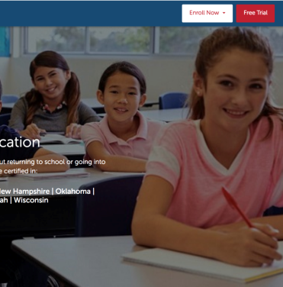
Free Trial
7 Day Free Trial Available!
No obligation. No credit card needed.
7 days to look over the entire program.
Try practice quizzes and practice exams.
Visit our website (listed below) and click on Free Trial in the top right corner.
www.americanboard.org

Slide 14
Contact Information
PHONE: 1-877-669-2228
Email: Info@AmericanBoard.org
Hours: Monday- Friday from 9am- 6pm EST.
Website: www.AmericanBoard.org

