Slide 1
Program Overview for South Carolina
For more information, visit: www.AmericanBoard.org
Notes:
First slide of ABCTE

Slide 2
American Board: A Summary
We are a non-profit organization, founded in 2001 by a grant from the U.S. Department of Education
We are an alternative route to teacher certification in over a dozen states
We help career changers earn teacher certification without returning to school or taking out student loans
We help communities deal with the teacher shortage by placing local, talented professionals in the classroom to share their experiences while educating the next generation of Americans

Slide 3
How It Works
All you need:
A Regionally Accredited Bachelor’s Degree in ANY field
Pass a standard Background Check
…that’s it!
What you do:
Study online for two exams- a subject area exam and our Professional Teacher Knowledge exam (PTK)
Pass both exams to earn our Teacher Certification
Complete American Board clinical experience program within first year teaching

Slide 4
How It Works
Program candidates have 12 MONTHS from the date of enrollment to work with our self-paced, self study program (average time to complete the program is 7-10 months)
Clinical Experience will take place within first year teaching on state temporary license.
Once ready to take either exam, you sign up at your local Pearson VUE Testing Center

Slide 5
How It Works
After both exams are passed, students will receive their American Board Certificate and SC Dept. of Education temporary teaching permit
While on the state temporary permit your first three years teaching…
You will participate in American Board Clinical Experience your first year teaching
Receive professional development, undergo standard observation hours, and complete a school district mentoring component
Pass the Principals of Learning and Teaching (PLT) Praxis Exam
Notes:
Point out here that the American Board teacher certification lasts for life, and that we have reciprocity with all other states that currently accept our certification.

Slide 6
How It Works
After completing local district and state requirements on your temporary teaching permit, you will be upgraded to the state-issued, full-time teaching permit.
At this point, you are fully certified and may continue to renew your full-time permit per state and local requirements every 5 years.
Notes:
Point out here that the American Board teacher certification lasts for life, and that we have reciprocity with all other states that currently accept our certification.

Slide 7
Resources for you:
American Board provides:
Online study materials in the form of an online textbook, standards, study plan, and practice exams to assess your own progress
Initial testing fees at Pearson VUE Testing Center are included in the cost of the program.
Clinical Experience

Slide 8
Student teaching is not required. Schools usually have a mentorship option in place to help new teachers.
What about student teaching?
We HIGHLY recommend substitute teaching prior to completing your certification with us. It’s a great way to assess which age group you prefer to work with.

Slide 9
Subject Areas offered in SC
Biology* (9-12)
Chemistry (9-12)
English* (5-12)
General Science (5-12)
Math* (5-12)
Physics (9-12)
* Premium Plan Available

Slide 10
SC Dept. of Ed. Requirements
Complete American Board program
Apply for Statement of Eligibility from D.O.E
Obtain an offer of employment and submit verification of offer to the Office of Educator Certification
Renew your Alternate Route Teaching Certificate annually for three years while completing formal evaluation requirements
Complete Clinical Experience within first year teaching
Pass Praxis PLT within first three years teaching
Apply to upgrade to your temporary teaching permit once all of these items are completed

Slide 11
How Much Does It Cost?
Installment Plan
9 payments of $298
= $2,682
Payment due on the 15th
of each month.
Enroll via application. Cannot enroll online.
One Time Payment
$1,900 -$2,200*
*check website for current promotion
Enroll online at any time!

Slide 12
Why American Board?
Being a fully self-paced, self-study program allows students to finish or focus on study material at their own pace, as they are not at the mercy of their instructor or classmates’ speed, and not confined to attending classes
We are much more affordable than similar alternative route to certification programs, as well as Master’s of Education programs
We are state approved, or state board of education approved in all states we are located, and fulfill all annual reporting to stay in compliance with state requirements and regulations, ensuring there are no additional steps required to student and school to become certified

Slide 13
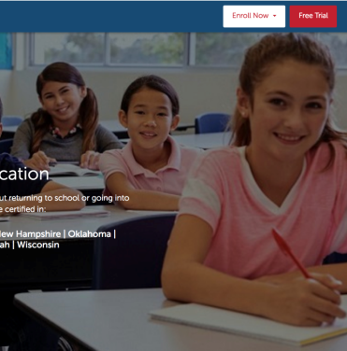
Free Trial
7 Day Free Trial Available!
No obligation. No credit card needed.
7 days to look over the entire program.
Try practice quizzes and practice exams.
Visit our website (listed below) and click on Free Trial in the top right corner.
www.americanboard.org

Slide 14
Contact Information
PHONE: 1-877-669-2228
Email: info@americanboard.org
Hours: Monday- Friday from 9am- 11pm EST
Website: www.AmericanBoard.org

