Slide 1
Program Overview for Oklahoma
For more information, visit: www.AmericanBoard.org
Notes:
First slide of ABCTE

Slide 2
American Board: A Summary
We are a non-profit organization, founded in 2001 by a grant from the U.S. Department of Education.
We are an alternative route to teacher certification in over a dozen states.
We help career changers earn teacher certification without returning to school or taking out student loans.
We help communities deal with the teacher shortage by placing local, talented professionals in the classroom to share their experiences while educating the next generation of Americans.
Notes:
We are not a school!

Slide 3
How It Works
All you need:
A Bachelor’s Degree in ANY field
Pass a standard Background Check
…that’s it!
What you do:
Study online for two exams- a subject area exam and our Professional Teacher Knowledge exam (PTK)
Take and pass these two exams to earn our Teacher Certification

Slide 4
How It Works
Candidates of the program have 12 MONTHS from the date of enrollment to work with our fully self-paced, self study program. (average time to complete the program is 7-10 months)
Once you are ready to take either exam, you sign up at your local Pearson VUE Testing Center.

Slide 5
How It Works
After both exams are passed, students will receive their American Board Teacher Certification. You present this to the Oklahoma Department of Education and receive a one-year, initial teaching license.
You will teach on this temporary license, while concurrently going through standard classroom observations and the American Board mentorship program ($595).
Notes:
Point out here that the American Board teacher certification lasts for life, and that we have reciprocity with all other states that currently accept our certification.

Slide 6
How It Works
After completing local district requirements and your mentorship on your temporary teaching permit, you can apply for the Oklahoma Standard License, a 5 year renewable permanent teaching certificate.
You are then fully certified and may continue to renew your full-time permit per state and local requirements.
Notes:
Point out here that the American Board teacher certification lasts for life, and that we have reciprocity with all other states that currently accept our certification.

Slide 7
Subject Areas Offered in Oklahoma
Biology* (6-12)
Chemistry (6-12)
English * (6-12)
General Science (6-12)
History** (6-12)
Math* (6-12)
Physics (6-12)
* = Premium Plan Available
** = Oklahoma allows candidates to certify in World History and/or U.S. History

Slide 8
Resources for you:
The American Board provides:
Online study materials (please note the History certification requires two physical textbooks; you can find them on Amazon.Com for about $20-$30 each)
Study Plans and practice quizzes to assess your own progress
Initial testing fees are included in the cost of the program.

Slide 9
Student teaching is not required. Schools usually have a mentorship option in place to help new teachers.
What about student teaching?
We HIGHLY recommend substitute teaching prior to completing your certification with us. It’s a great way to assess which age group you prefer to work with.

Slide 10
How Much Does It Cost?
Installment Plan
9 payments of $298
= $2,682
Payment due on the 15th
of each month.
Enroll via application. Cannot enroll online.
One Time Payment
$1,900 -$2,200*
*check website for current promotion
Enroll online at any time!

Slide 11
Why American Board?
Being a fully self-paced, self-study program allows students to finish or focus on study material at their own pace, as they are not at the mercy of their instructor or classmates speed, and not confined to attending classes.
We are much more affordable than similar alternative route to certification programs, as well as Master’s of Education programs.
We are state approved, or state board of education approved in all states we are located, and fulfill all annual reporting to stay in compliance with state requirements and regulations, ensuring there are no additional steps required to student and school to become certified.

Slide 12
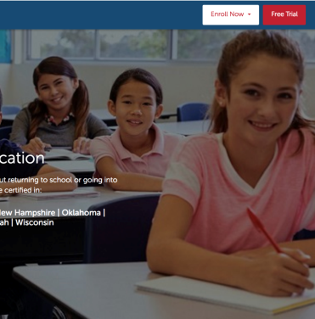
Free Trial
7 Day Free Trial Available!
No obligation. No credit card needed.
7 days to look over the entire program.
Try practice quizzes and practice exams.
Visit our website (listed below) and click on Free Trial in the top right corner.
www.americanboard.org

Slide 13
Contact Information
PHONE: 1-877-669-2228
Email: Info@americanboard.org
Hours: Monday- Friday from 9am- 11pm EST.
Website: www.AmericanBoard.org

