Slide 1
Program Overview for Florida
For more information, visit: www.AmericanBoard.org
Notes:
First slide of ABCTE

Slide 2
American Board: A Summary
We are a non-profit organization, founded in 2001 by a grant from the U.S. Department of Education.
We are an alternative route to teacher certification in over a dozen states.
We help career changers earn teacher certification without returning to school or taking out student loans.
We help communities deal with the teacher shortage by placing local, talented professionals in the classroom to share their experiences while educating the next generation of Americans.

Slide 3
How It Works
All you need:
A Bachelor’s Degree in ANY field
Pass a standard Background Check
…that’s it!
What you do:
Study online for two exams- a subject area exam and our Professional Teacher Knowledge exam (PTK)
Take and pass these two exams to earn our Teacher Certification

Slide 4
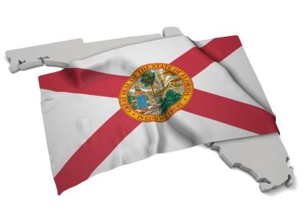
About the General Knowledge Exam
If you do not yet have a Temporary Teaching Permit in Florida, candidates of the American Board program are exempt from taking the Florida General Knowledge exam (the GK).
That’s one less exam to take in order to earn teaching certification in Florida.

Slide 5
How It Works
Candidates of the program have 12 MONTHS from the date of enrollment to work with our fully self-paced, self study program (average time to complete the program is 7-10 months).
Once you are ready to take either exam, you sign up at your local Pearson VUE Testing Center.

Slide 6
How It Works
After both exams are passed, students will receive their American Board Teacher Certification.
You present this to the state department of education and apply and complete their professional development requirements (don’t worry, those slides are coming up…)
You will teach on your provisional license for one year, while concurrently going through standard classroom observations and school district’s mentorship program.
Notes:
Point out here that the American Board teacher certification lasts for life, and that we have reciprocity with all other states that currently accept our certification.

Slide 7
How It Works
After completing local district and state requirements on your temporary teaching permit, you will be upgraded to the state-issued, full-time teaching permit.
You are then fully certified and may continue to renew your full-time permit per state and local requirements.
Notes:
Point out here that the American Board teacher certification lasts for life, and that we have reciprocity with all other states that currently accept our certification.

Slide 8
Resources for you:
The American Board provides:
One full year access to our online certification program
Online textbook, standards, study plan, and follow up practice quizzes to assess your own progress.
Initial testing fees are included in the cost of the program.
Notes:
Everything is online!!!!!!!

Slide 9
Student teaching is not required. Schools have a mentorship option in place to help new teachers.
What about student teaching?
We HIGHLY recommend substitute teaching prior to completing your certification with us. It’s a great way to assess which age group you prefer to work with.

Slide 10
Subject Areas Offered in Florida
Biology* (6-12)
Chemistry (6-12)
Elementary Ed. (K-6)
English * (6-12)
General Science (5-9)
Math* (6-12)
Special Education* (K-6, 6-12)
Physics (6-12)
* = Premium Plan Available

Slide 11
Please Note:
In Florida, if you would like to certify with Special Education, you must initially certify in another area, as it is viewed as an endorsement area. We provide Elementary Education free-of-charge to fulfill this state requirement.
If using our program to transfer your temporary teaching permit (received before beginning with us based on degree evaluation with FLDOE) you must take our subject area exam, Professional Teaching Knowledge exam, have taught for a full year, and take the Florida General Knowledge Exam, at which point you’ll receive the state issued, full time license.
(we don’t make these rules, the FLDOE does…)

Slide 12
Florida Dept. of Ed. Requirements
Complete the American Board program
Apply to FLDOE and complete the appropriate FLDOE licensure application form
Obtain a teaching position in a Florida public school (Must be a public or charter school.)
Submit evidence of job offer to FLDOE and complete a criminal background check

Slide 13
Florida Dept. of Ed. Requirements
Apply for initial 3-year non-renewable provisional teaching license
Teach one full year, while completing school mentorship (Florida Demonstration Program)
Complete appropriate FLDOE licensure application form and payment.
Receive state issued, full time teaching license (Florida Professional Certificate)

Slide 14
How Much Does It Cost?
Installment Plan
9 payments of $298
= $2,682
Payment due on the 15th
of each month.
Enroll via application. Cannot enroll online.
One Time Payment
$1,900 -$2,200*
*check website for current promotion
Enroll online at any time!

Slide 15
Why American Board?
Being a fully self-paced, self-study program allows students to finish or focus on study material at their own pace, as they are not at the mercy of their instructor or classmates’ speed, and not confined to attending classes.
We are much more affordable than similar alternative route to certification programs, as well as Master’s of Education programs.
We are state approved, or state board of education approved in all states where we offer our program, and fulfill all annual reporting to stay in compliance with state requirements and regulations, ensuring there are no additional steps required to student and school to become certified.

Slide 16
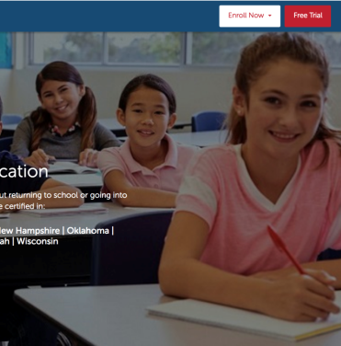
Free Trial
7 Day Free Trial Available!
No obligation. No credit card needed.
7 days to look over the entire program.
Try practice quizzes and practice exams.
Visit our website (listed below) and click on Free Trial in the top right corner.
www.americanboard.org

Slide 17
Contact Information
PHONE: 1-877-669-2228
Email: Info@AmericanBoard.Org
Hours: Monday- Friday from 9am- 6pm EST.
Website: www.AmericanBoard.org

